Slide 1
MILESTONE 2 ECS 165A

Slide 2
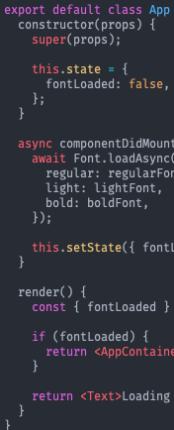
HIJK TEAM
Names:
Hanxing Zhang Isabella Pitco Jennifer Ly Kauana dos Santos

Slide 3
APP PERSONALITY & APP PERSONA
What does the user want?

Slide 4
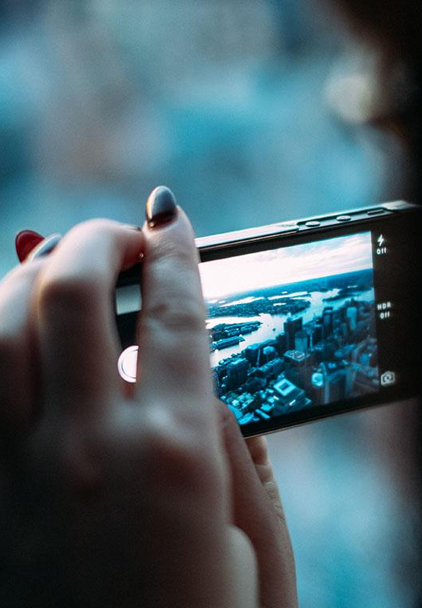
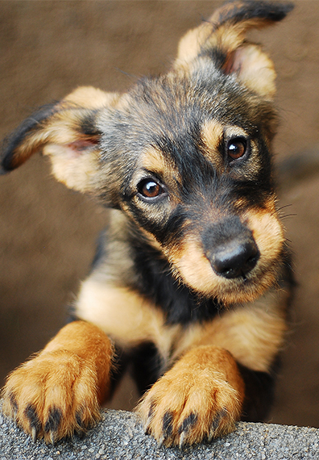
BUILDING A COMMUNITY
Our pets are a part of our families.
Our goal is to foster a community of pet lovers and help users discover resources that they can depend on.

Slide 5
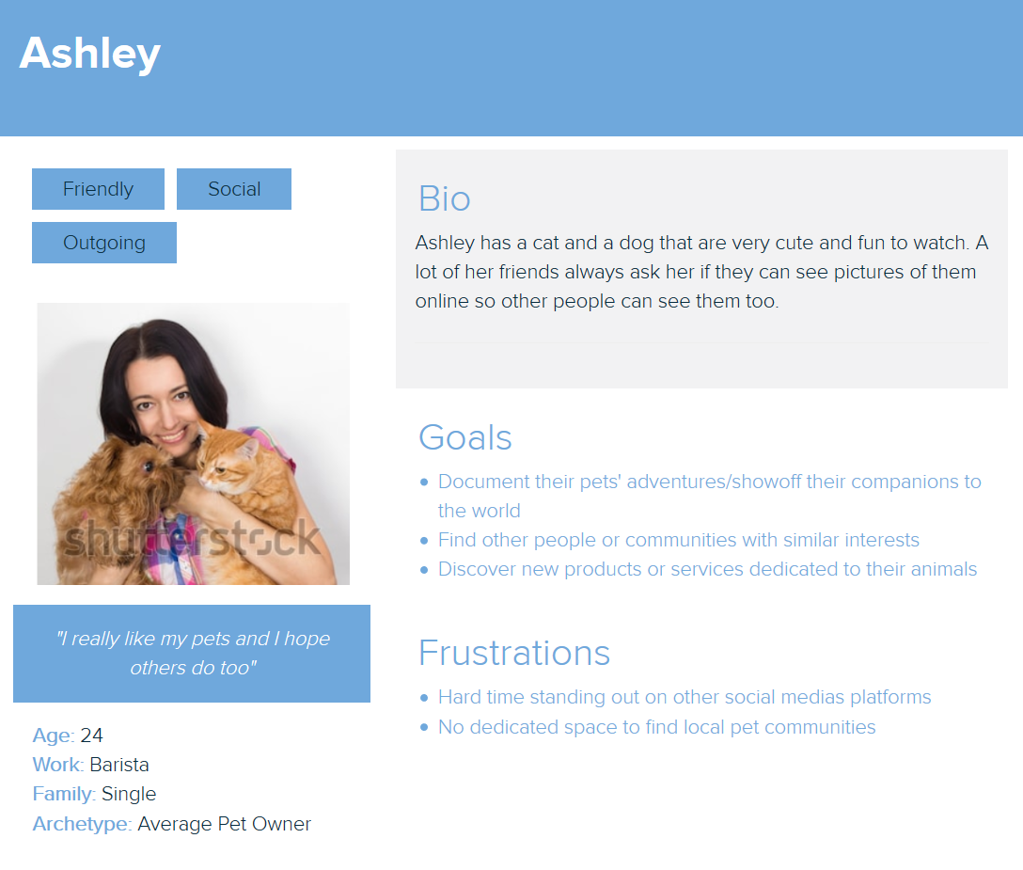
USER PERSONA #1
THE PET MOM

Slide 6
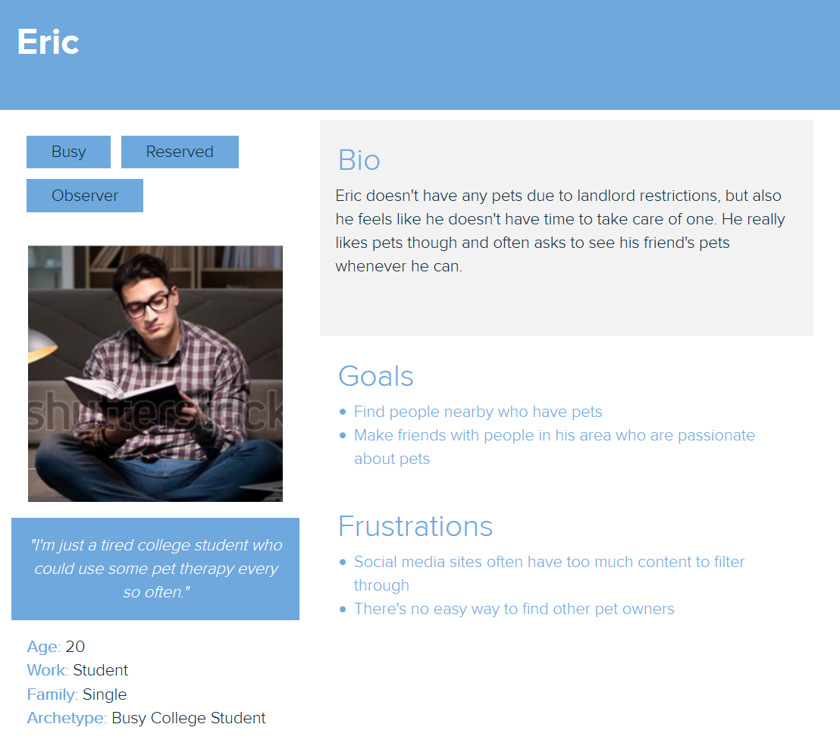
USER PERSONA #2
THE VICARIOUS ANIMAL LOVER

Slide 7
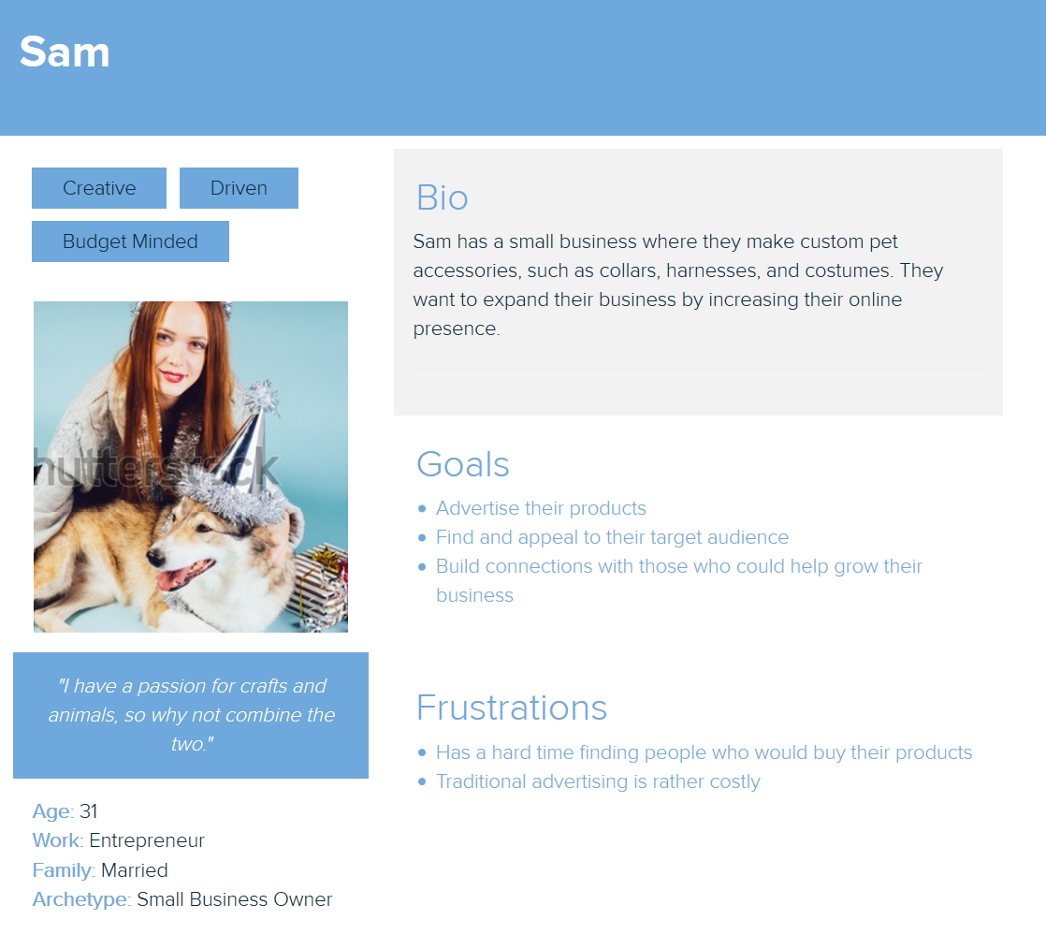
USER PERSONA # 3 THE BUSINESS OWNER

Slide 8
APP PERSONALITY
Our app should reflect our users
Modern
Entertaining
Fun!
Thoughtful
Accessible

Slide 9

APP PERSONALITY

Slide 10
FRONTEND DESIGN
UX and UI Wireframes

Slide 11
DESIGN GOALS
Intuitive
Users should be able to interact with the app without confusion. The most important features should be easily accessible.
Minimalistic
Focus on necessary information and avoiding distracting clutter. We want a simple, straight forward look.
Inviting
Our design is what users first judge-- we want them to come back! Create a calming, and enjoyable atmosphere.

Slide 12
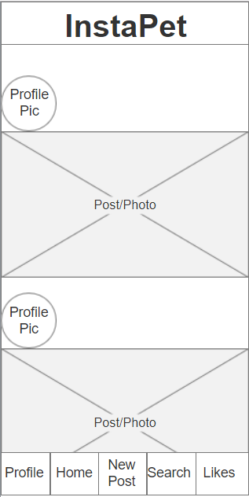
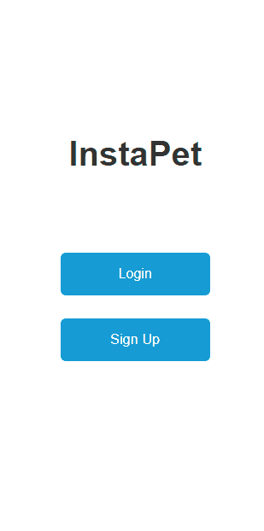
UX DESIGN
Organizing layout and basic features of the user interface.

Slide 13
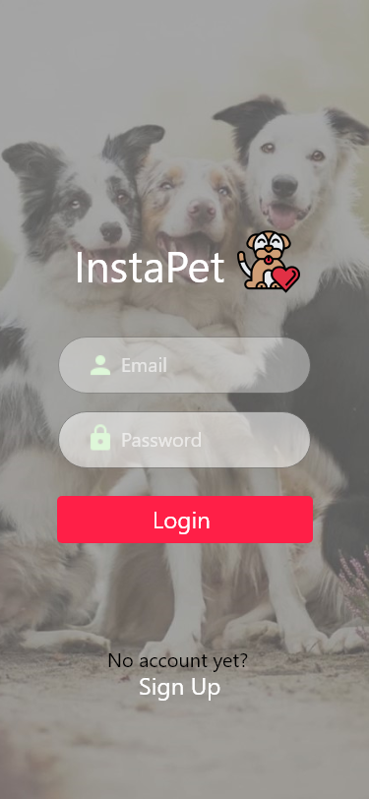

UI DESIGN
Implementing color scheme, icons, and the overall aesthetic of the app.

Slide 14
APP DEMO
Sign Up/Login Flow and Edit Profile

Slide 15
DATABASE DESIGN
Logical Design and Example Queries

Slide 16
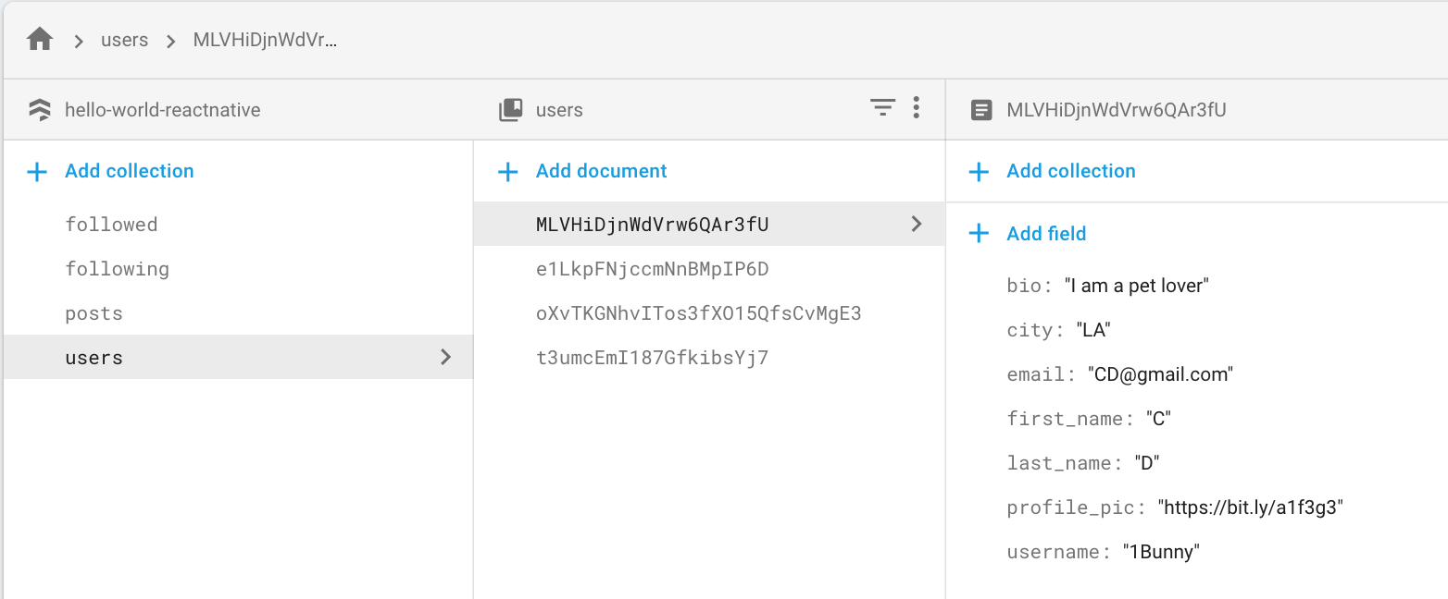
DATA MODEL IN CLOUD FIRESTORE:
USERS
Primary key for users

Slide 17
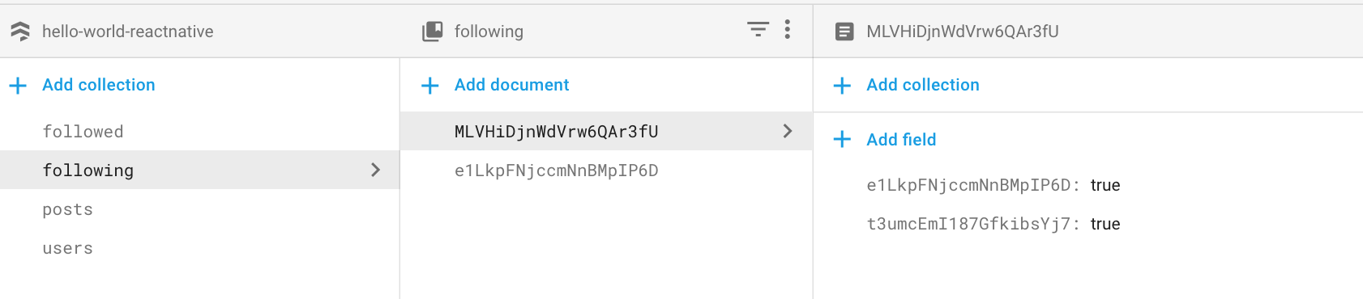

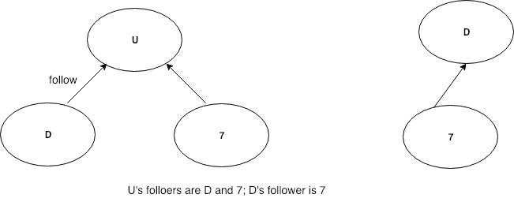
DATA MODEL IN CLOUD FIRESTORE:
FOLLOWING
Primary key for following

Slide 18
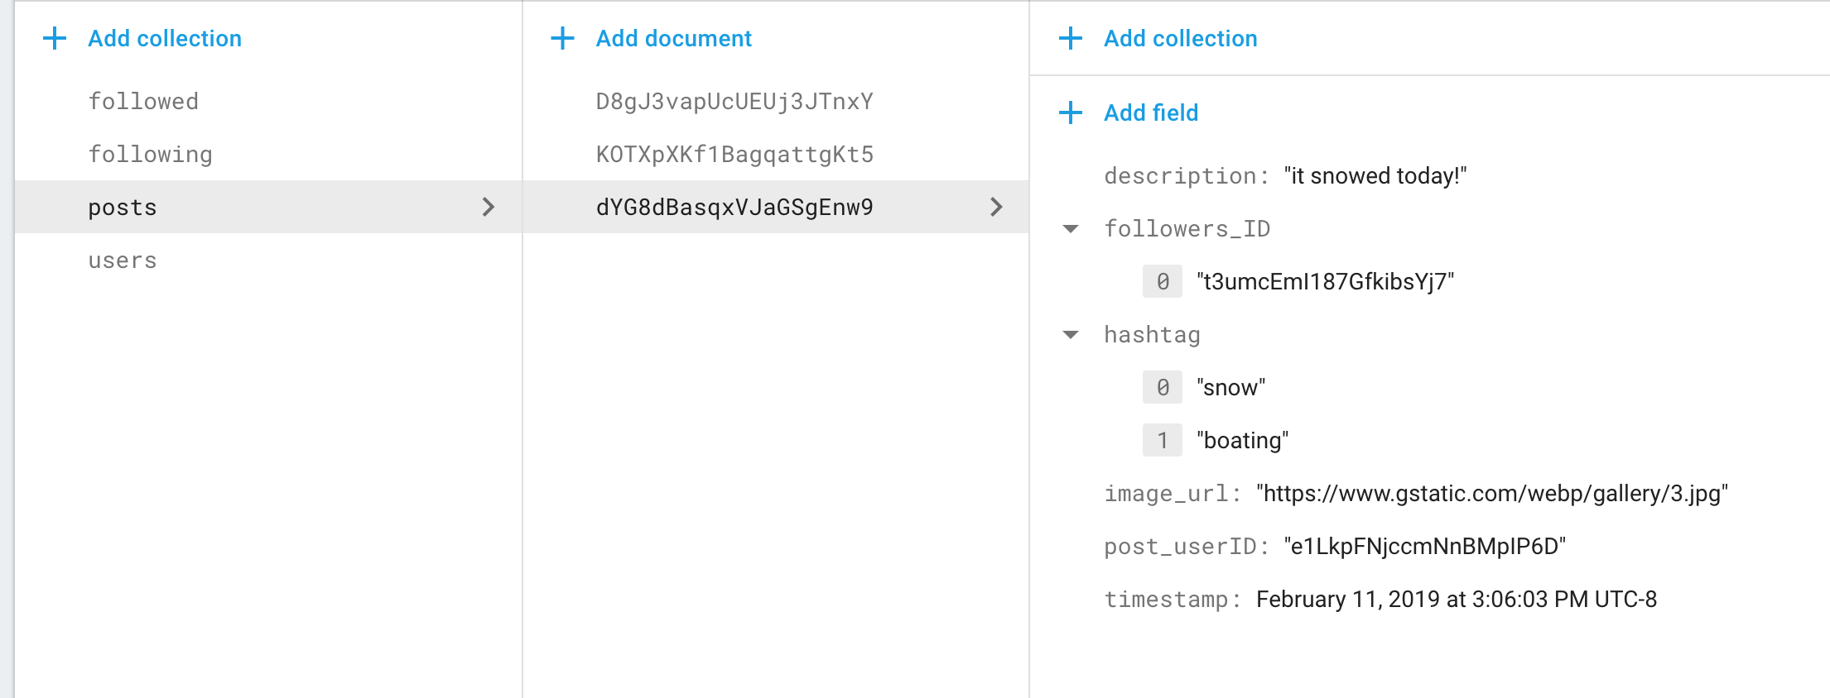
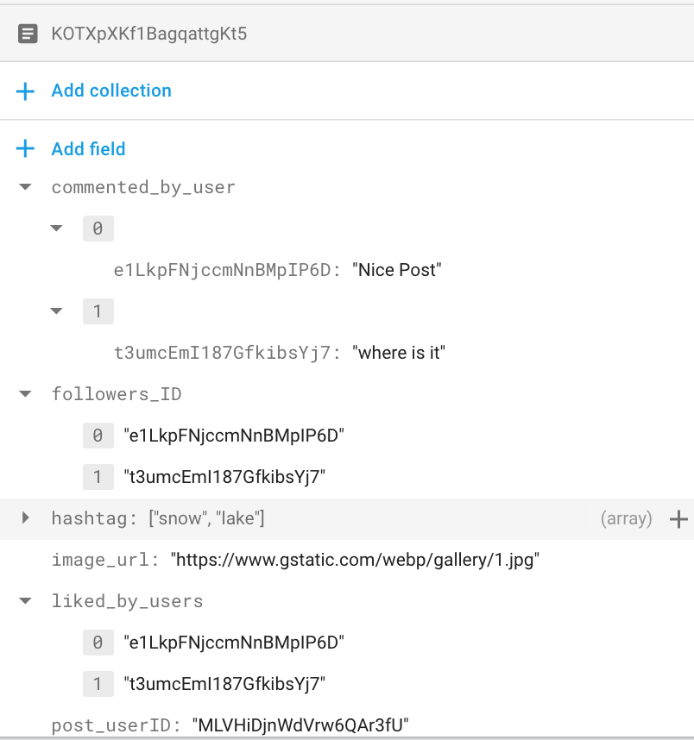
DATA MODEL IN CLOUD FIRESTORE:
POSTS
Primary key for posts
A post can only have one author
Another post with comments and likes
Foreign key in users and following

Slide 19
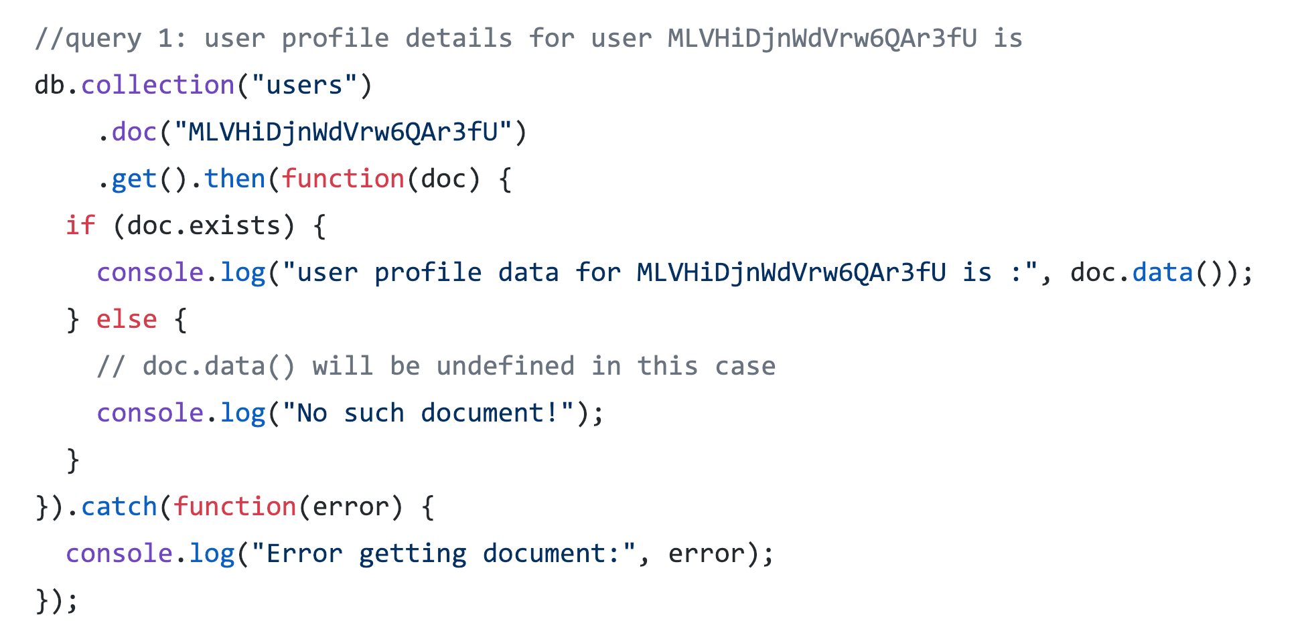
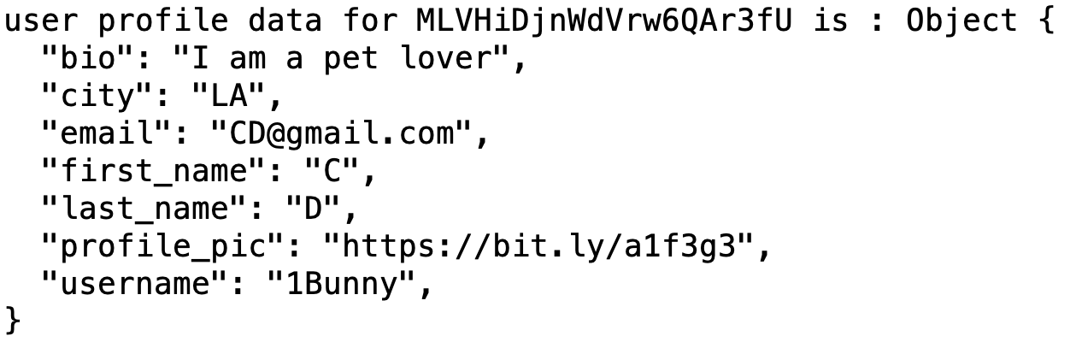
GIVEN A USER, FIND THEIR PROFILE DATA

Slide 20
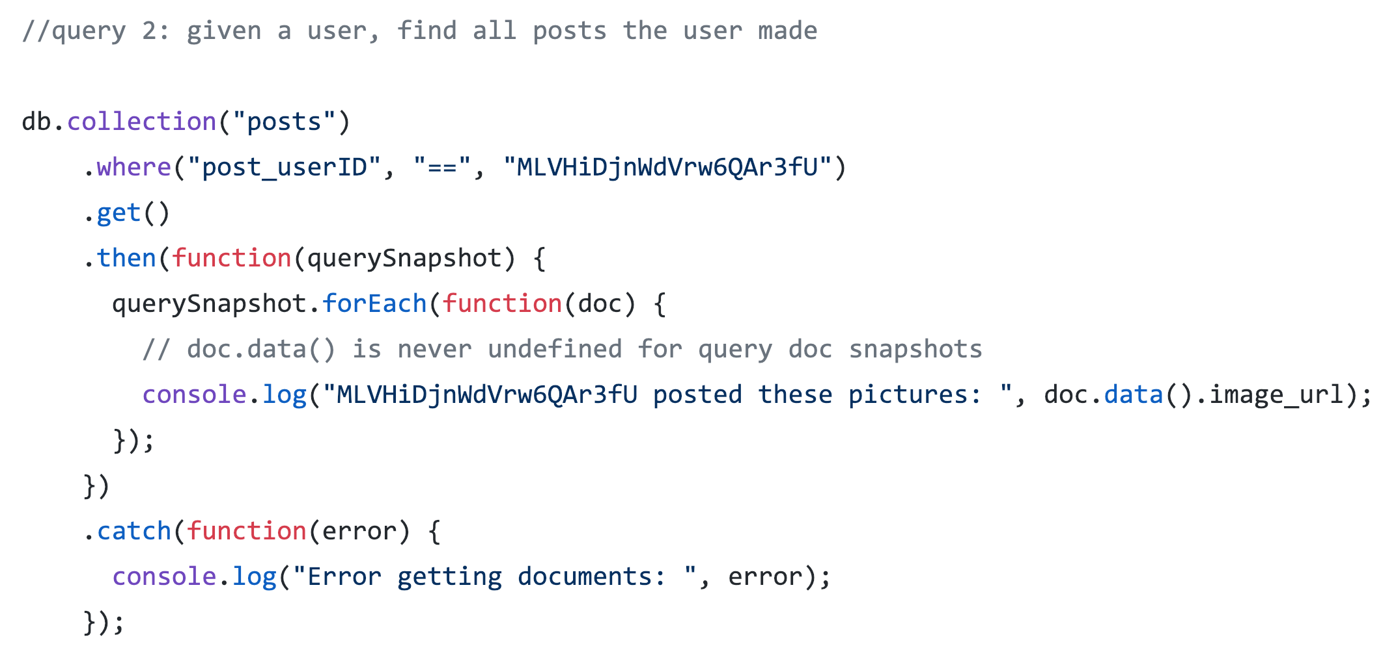
GIVEN A USER, FIND ALL THE POSTS THE USER HAS POSTED

Slide 21
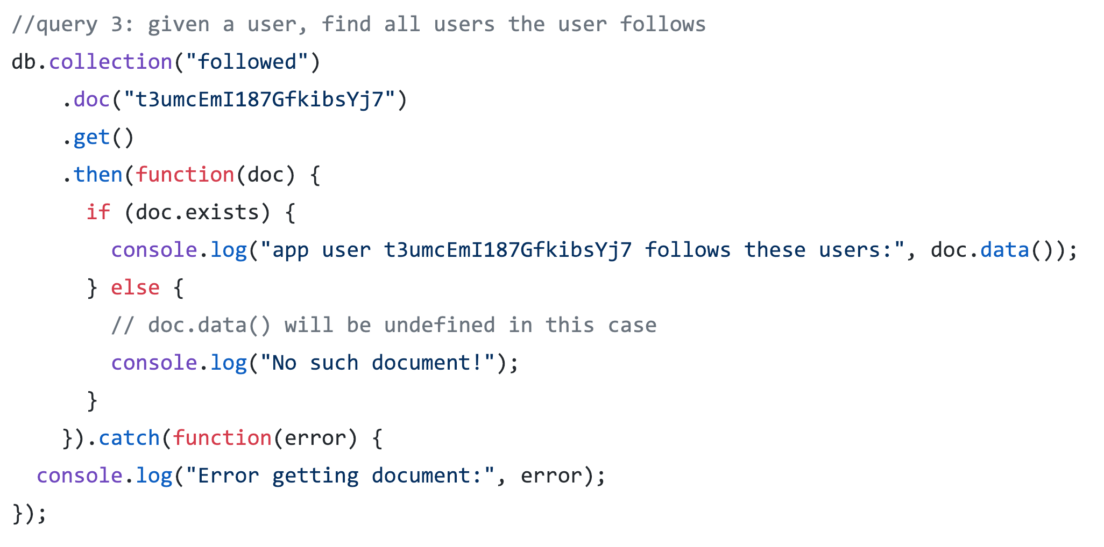
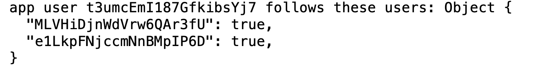
GIVEN A USER, FIND ALL PEOPLE THE USER FOLLOWS

Slide 22
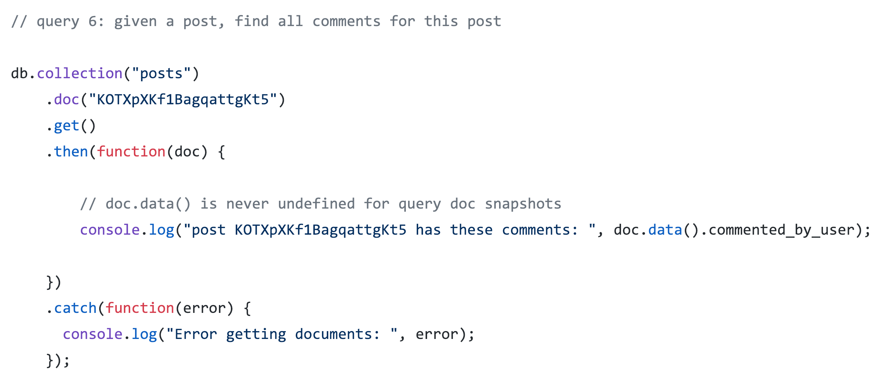
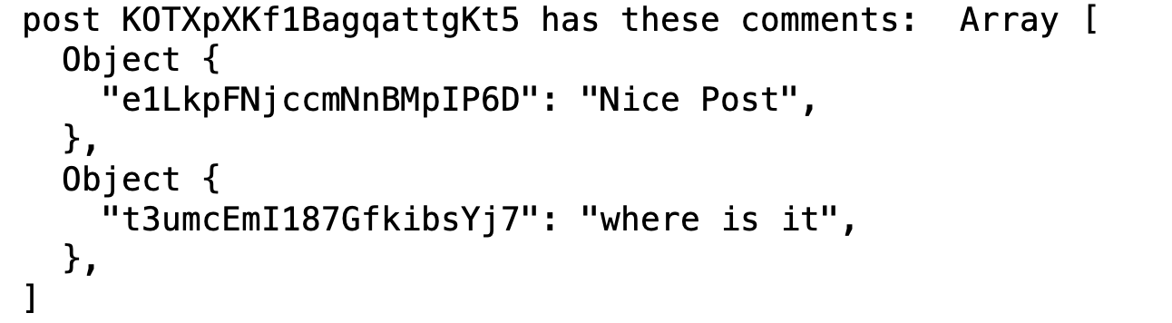
GIVEN A POST, FIND ALL COMMENTS OF THIS POST

Slide 23
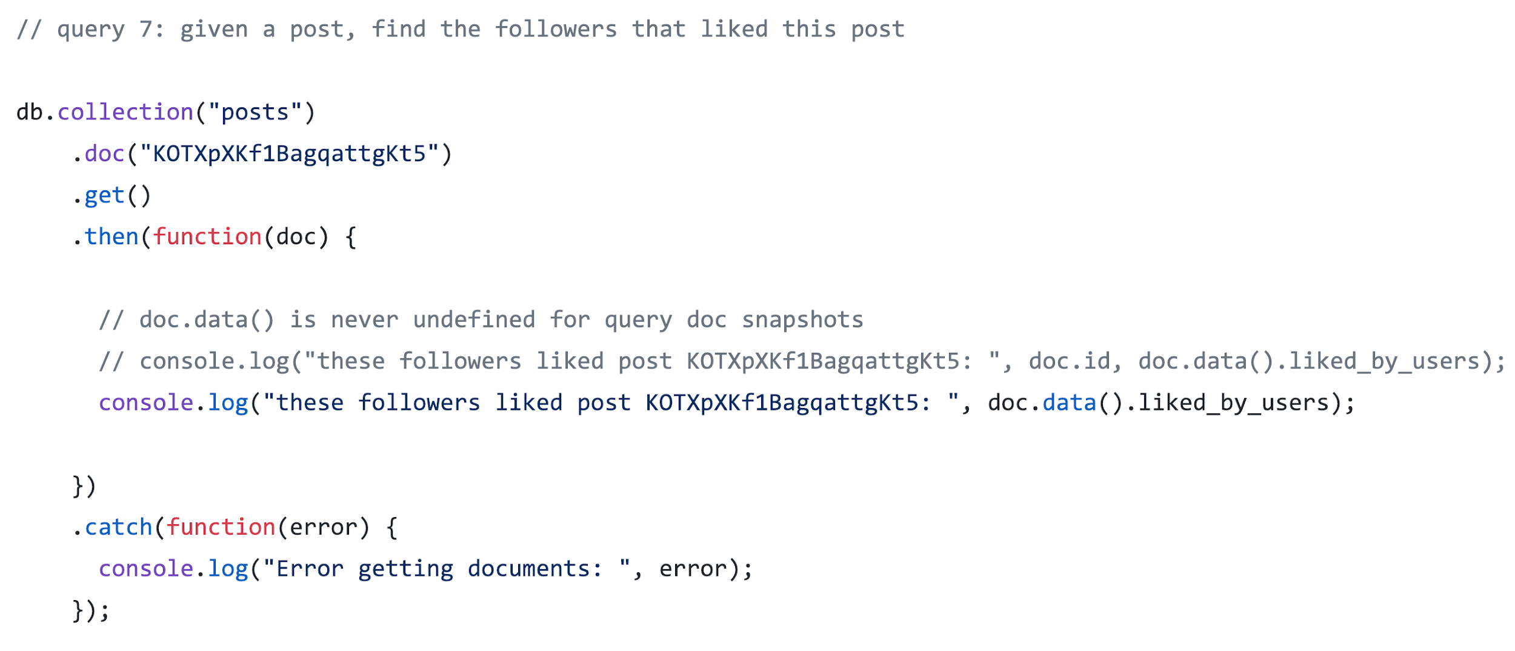
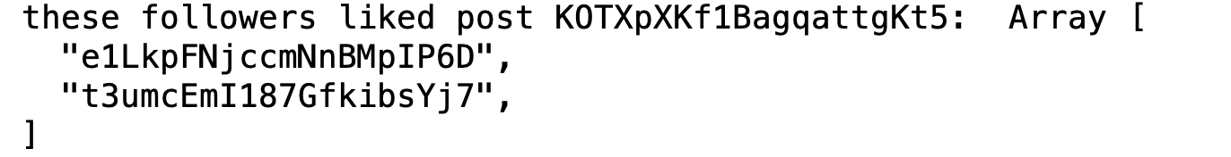
GIVEN A POST, FIND ALL PEOPLE WHO LIKED THIS POST

Slide 24
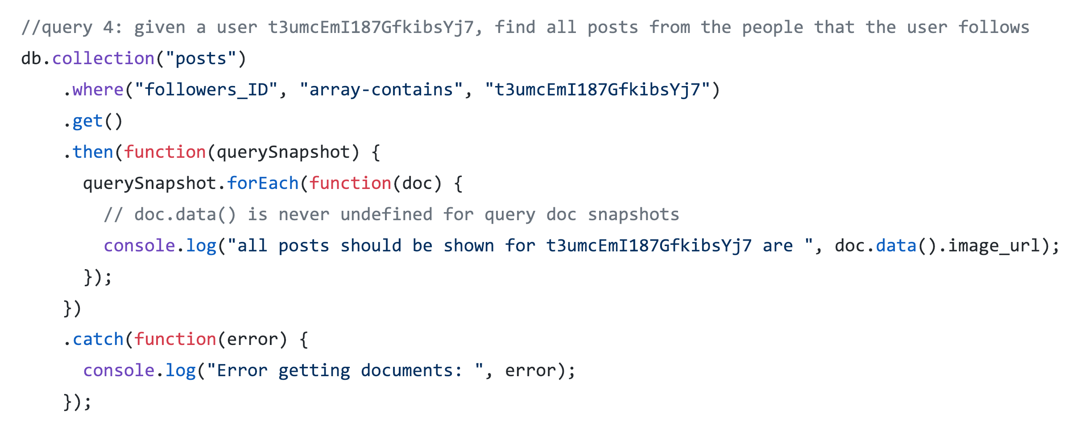
GIVEN A USER, FIND ALL POSTS FROM THE PEOPLE THAT THE USER FOLLOWS
With replication of following collection for each post, we can do this query easily:

Slide 25
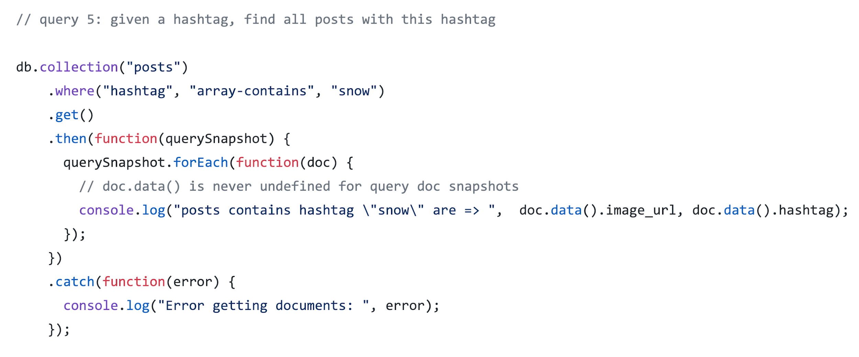
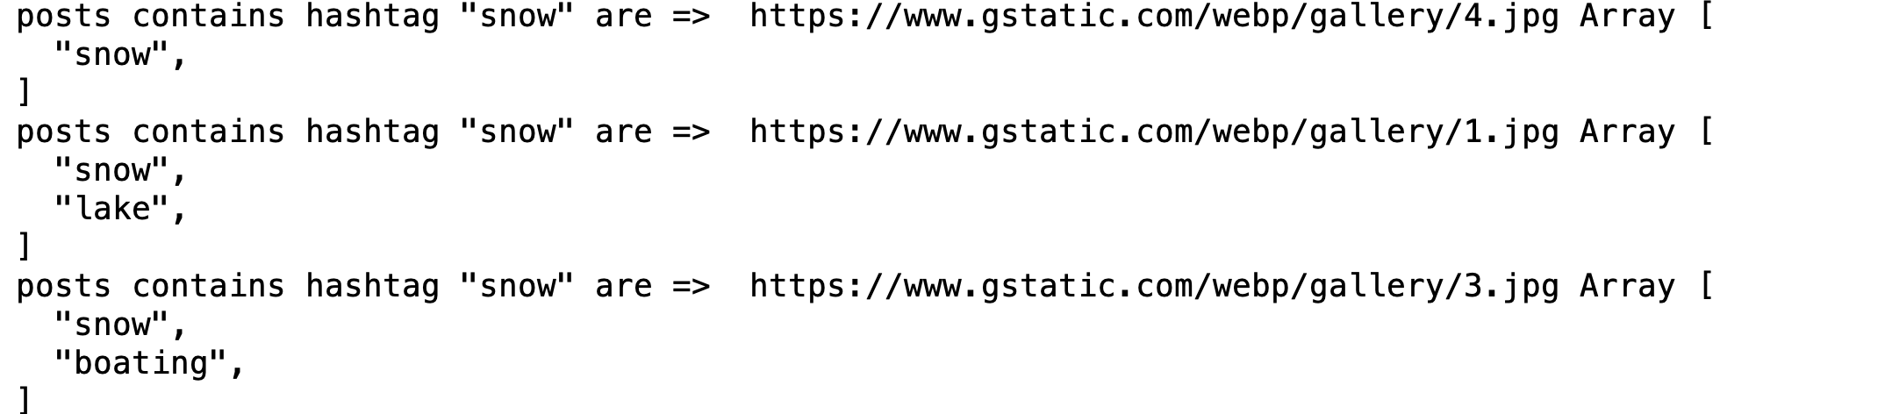
GIVEN A HASHTAG, FIND ALL POSTS WITH THIS HASHTAG

Slide 26
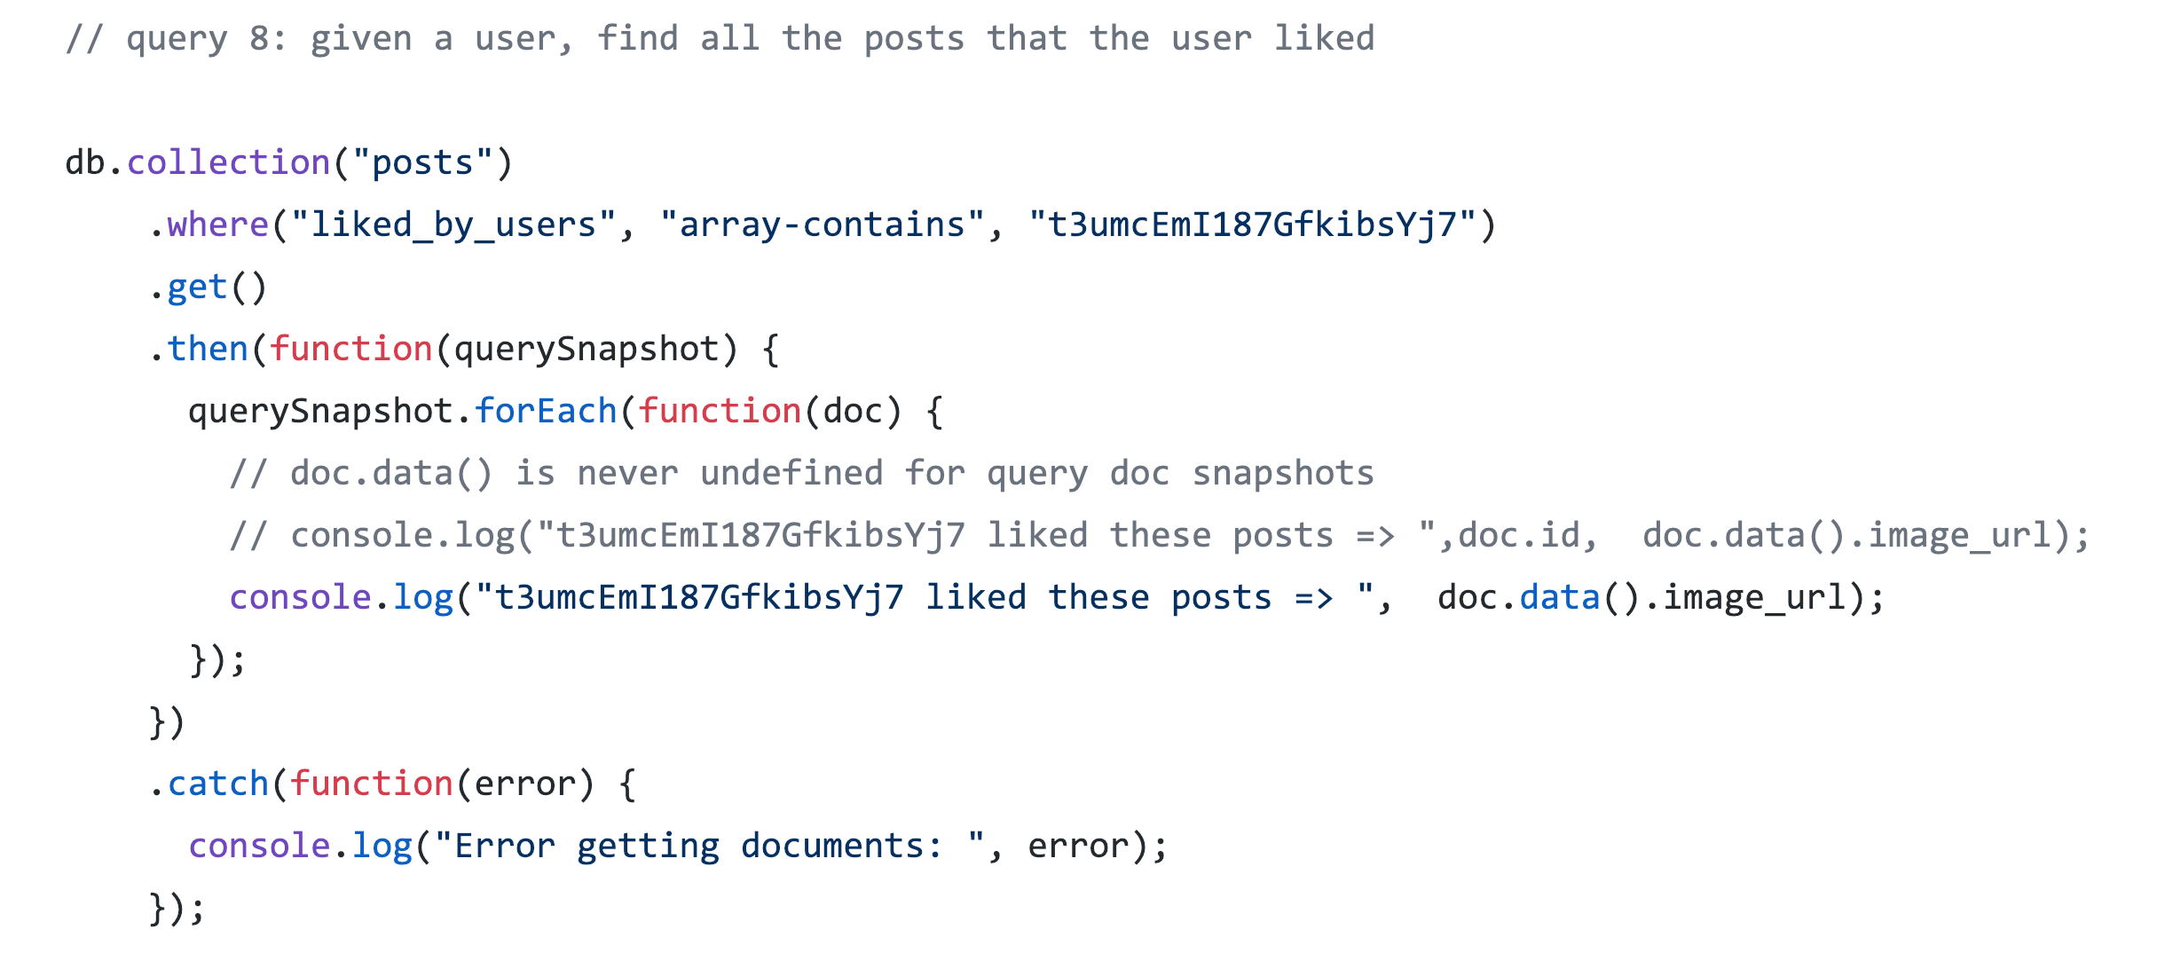
GIVEN A USER, FIND ALL POSTS THE USER LIKED

Slide 27
CREDITS
Special thanks to all the people who made and released these awesome resources for free:
Presentation template by SlidesCarnival
Icons by Freepik at FlatIcon.com and Material Design at https://materialdesignicons.com/
React Native Elements example by Monte9 at https://bit.ly/2GDTPOY
React Native & Firebase authentication by Faraz Amiruddin Ahmad at https://bit.ly/2K8IdT1
Color palette by picmonkey.com
App Persona Template by https://app.xtensio.com/

Slide 28
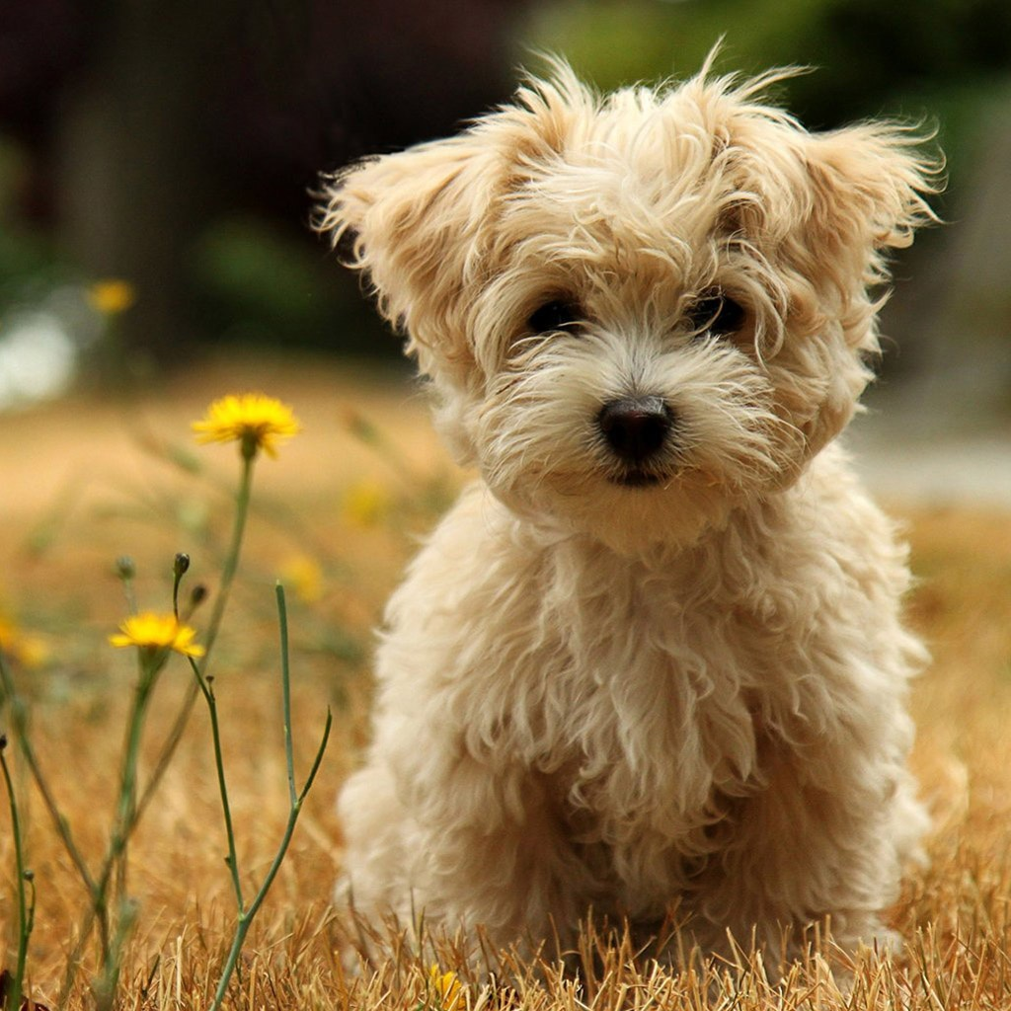

THANKS!
Questions?

